Slide 1
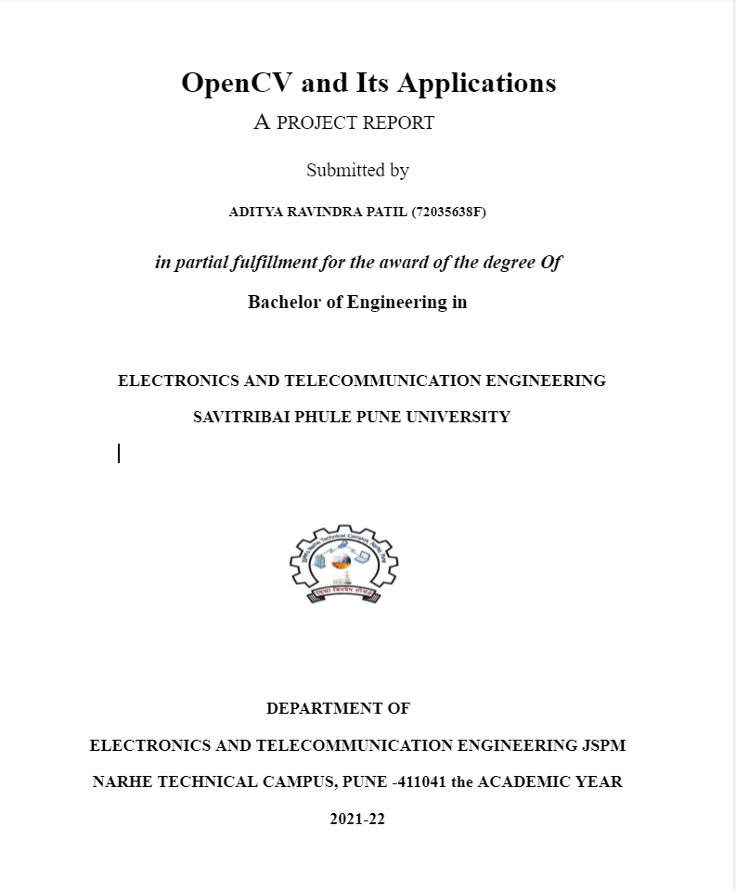

Slide 2
OpenCV and Its Application
Mini Project:
_ Aditya Patil

Slide 3
ACKNOWLEDGEMENT
In the present world of competition, there is a race of existence in which those are having the will to come forward succeed. A project is like a bridge between theoretical and practical working. With this willingness, we joined a particular project.
We would like to convey our deepest gratitude to our respected project guide,
Prof. Mrs. K.P.Wagh for her help and guidance throughout the duration of work.
We would like to convey our hearty thanks to all of our staff members and the Head of Department, Prof.Dr.M.M.Sardeshmukh for all kinds of coordination related to the project and for allowing us to use the college resources required for the project.
We would thank our parents for standing behind us all the time and we thank our friends for their advice, guidance, and help.
Last but not the list we express our sincere thanks to the institute, JSPM Narhe Technical Campus, Pune for such a good platform for implementing the ideas in our minds.
_Aditya Patil

Slide 4
Introduction
This project is about taking a gentle look at the Application of OpenCV with Viola-Jones Face Detection Technique, popularly known as Haar Cascades, and exploring some of the interesting applications of OpenCV. This piece of work was done long before the Deep Learning Era had even started. But it’s an excellent work in comparison to the powerful models that can be built with the modern-day Deep Learning Techniques. The algorithm is still found to be used almost everywhere. It has fully trained models available on GitHub. It’s fast. It’s pretty accurate (at least when I try it).
OpenCV (Open-Source Computer Vision Library) is an open-source computer vision and machine learning software library. OpenCV was built to provide a common infrastructure for computer vision applications and to accelerate the use of machine perception in commercial products. Being a BSD-licensed product, OpenCV makes it easy for businesses to utilize and modify the code.
This is a project that deals with implementations of OpenCV and its practical applications. OpenCV brings a lot of functionality within itself alone but when combined with a high community-supported language like python the applications can be vast.
In this project first, we go through how a certain, simple algorithm (Haar cascade) is used to get to a specific result or application, in our case which is Face detection and later on we see how complex and real-time applications via OpenCV are handled.

Slide 5
Objectives
The main objective of the proposed system is to implement real-time monitoring and automatic control. The proposed system will be easy to use and understand, small in size, robust, and cost-effective. It will give monitoring of data in real-time. The control system will be completely automated and hence will reduce the need for human involvement once the system has been deployed.

Slide 6
Motivation and Scope
We live in an era where almost everything is digital and automatic. To take that trend forward OpenCV can help a lot by just watching things for itself and collecting the data processing it and implementing it according to the functionality that we have set.
Applications of OpenCV can be widely used in many fields to make work and processes automatic and save human resources. Face detection can be used for getting the attendance of students, keeping track of people at a certain event, focusing on humans in a photograph, etc. OpenCV when used with the media-pipe hand's module the application range is huge and quite useful ex. Gesture control, sign language detection, Supervising hand-related training, and so on... Similarly, object detection can be used in a lot of industries.

Slide 7
Objectives
The main objective of the proposed system is to implement real-time monitoring and automatic control. The proposed system will be easy to use and understand, small in size, robust, and cost-effective. It will give monitoring of data in real-time. The control system will be completely automated and hence will reduce the need for human involvement once the system has been deployed.

Slide 8
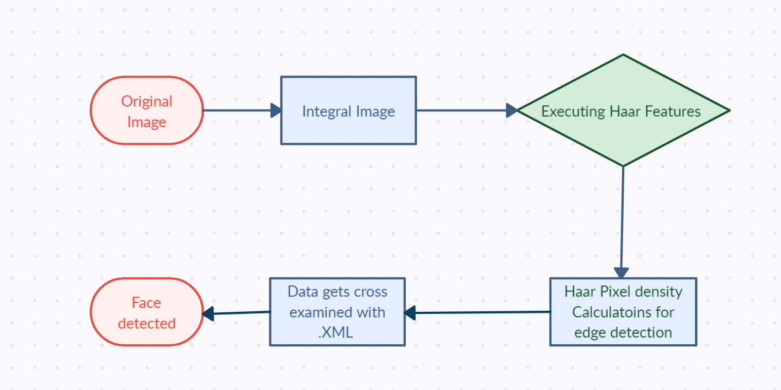
Flow

Slide 9
Hardware Specification
The hardware needed for this project is a basic laptop with no extraordinary specs(Graphics card, 8+GB ram, core i3+)
Hardware Specs:
1.)Computer/Laptop:
a)Ram 4 GB minimum required.
b)No intensive Graphics card is required.
c)Processor intel core i3 (minimum).
2.) Camera:
720P is the minimum requirement for a camera, a lower resolution camera can be used but the final results will show more errors for unclear images.

Slide 10
Software Specifications
As this project is software-intensive there are quite a few dependencies that are required for its functionality
The program is made using python version 3.9 and some modules
Here I have divided the required modules into their own categories:
OpenCV
OpenCV (Open Source Computer Vision Library) is an open-source computer vision and machine learning software library. OpenCV was built to provide a common infrastructure for computer vision applications and to accelerate the use of machine perception in commercial products. Being a BSD-licensed product, OpenCV makes it easy for businesses to utilize and modify the code.
Numpy
NumPy is the fundamental package for scientific computing in Python. It is a Python library that provides a multidimensional array object, various derived objects (such as masked arrays and matrices), and an assortment of routines for fast operations on arrays, including mathematical, logical, shape manipulation, sorting, selecting, and I/O.
MediaPipe
MediaPipe is a Framework for building machine learning pipelines for processing time-series data like video, audio, etc. This cross-platform Framework works in Desktop/Server, Android, iOS, and embedded devices like Raspberry Pi and Jetson Nano.

Slide 11
Software Development
Algorithm
This Project is about taking a gentle look at the Viola-Jones Face Detection Technique, popularly known as Haar Cascades, and exploring some of the interesting concepts proposed by them. This piece of work was done long before the Deep Learning Era had even started. But it’s an excellent work in comparison to the powerful models that can be built with the modern-day Deep Learning Techniques. The algorithm is still found to be used almost everywhere. It has fully trained models available on GitHub. It’s fast. It’s quite accurate.

Slide 12
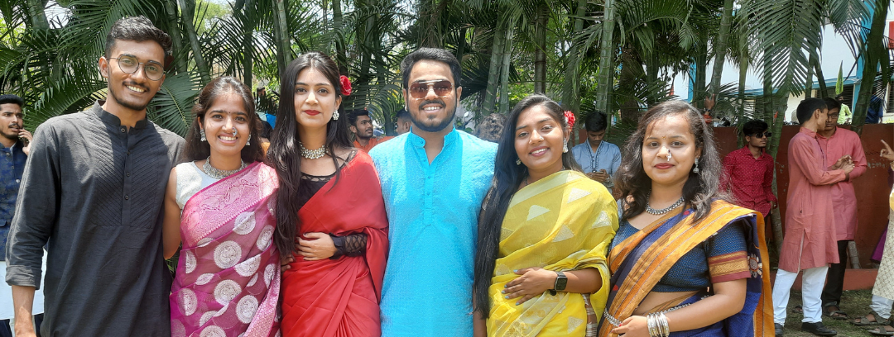
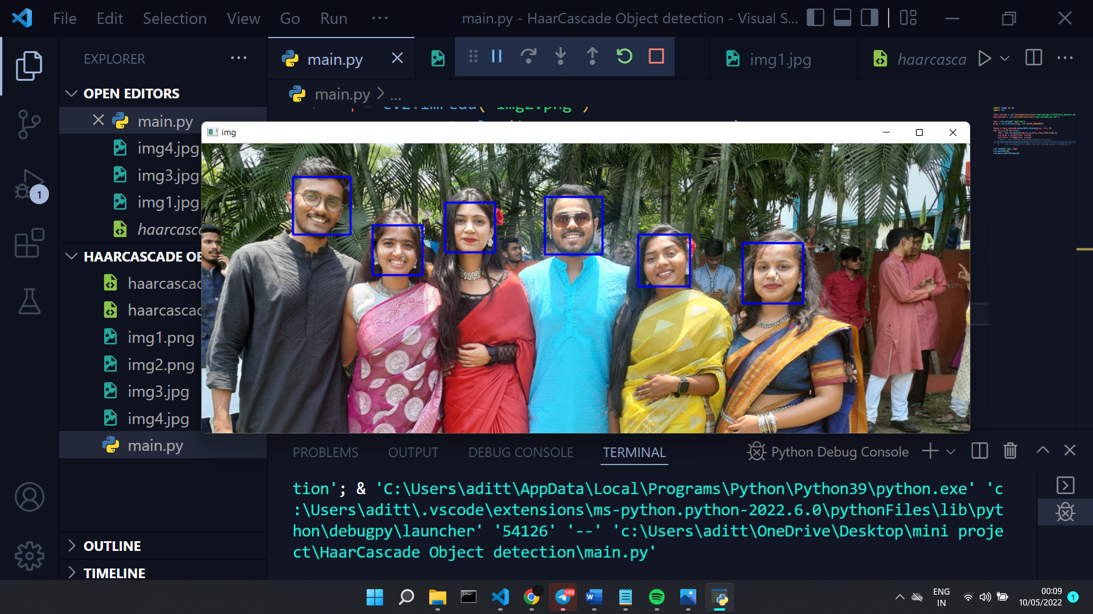
Results
Haar Cascade Detection is one of the oldest yet most powerful face detection algorithms invented. It has been there for a long, a long before Deep Learning became famous. Haar Features were not only used to detect faces but also for eyes, lips, license number plates, etc. The models are stored on GitHub, and we can access them with OpenCV methods.

Slide 13
ADVANTAGES
The advantage of OpenCV (Face detection) are enormous and can be used in almost every industry.
Face detection with Haar Cascade is a very efficient way of detecting faces as its requirement are very less due to the use of things like the use of XML and Python.
Advantages can be listed as:
1.)It's fast compared to other algorithms for face detection.
2.)It’s convenient to use as it's an in-built function of OpenCV.
3.)Haar cascade algorithm is not hardware intensive.
4.)Haar cascade can be used in the actual project due to precise calculations.
5.)Haar cascade algorithm is widely used and easy to understand to use it.

Slide 14
DISADVANTAGES
The advantage of OpenCV (Face detection) are enormous and can be used in almost every industry.
Face detection with Haar Cascade is a very efficient way of detecting faces as its requirement are very less due to the use of things like the use of XML and Python.
Advantages can be listed as:
1.)It's fast compared to other algorithms for face detection.
2.)It’s convenient to use as it's an in-built function of OpenCV.
3.)Haar cascade algorithm is not hardware intensive.
4.)Haar cascade can be used in the actual project due to precise calculations.
5.)Haar cascade algorithm is widely used and easy to understand to use it.

Slide 15
Applications
1.)Attendance a class.
2.)Optimisation of camera focus.
3.)For various security purposes “watching” is needed.

Slide 16
Conclusion
.We Conclude that with OpenCV we can do a lot of things where Images or videos are available and by processing and passing that Image through certain algorithms based on our functionality.
OpenCV is a well-known library and has huge community support leading to ease in any task an individual wants to perform.
Like Haar Cascade, there are many other useful and optimized algorithms to support most of the project ideas we can think of, and learning and modifying those algorithms is quite easy.

Slide 17
Future Scope
In the world that we live in OpenCV has a lot of potentials to back any “Vision” oriented project. The community support for OpenCV is huge and many Experts are backing it up meaning that the library is being better every day.
With OpenCV, many things can e automated by just taking the image input and adding a script to it based on what you want to do.
Image processing is fast in most cases leading to automation efficiency and handy.
OpenCV and its Applications can be widely used in near future. It has a use case in Hospitals, Schools, Library, Stations, and many Public places where CCTV camera is being used.With the help of OpenCV CCTV cameras will have a whole other dimension of use cases as we won't just be using them for observing but also for performing tasks.

